Slide 1

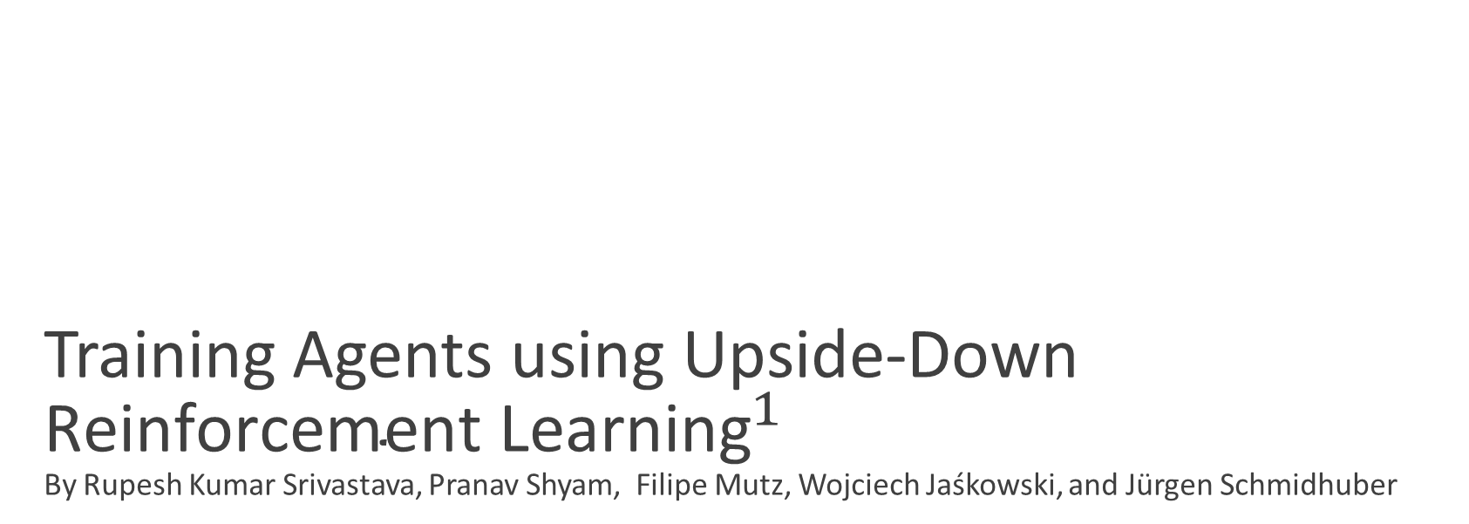
Training Agents using Upside-Down ${\text{Reinforcement} \text{Learning}}^{1}$ By Rupesh Kumar Srivastava, Pranav Shyam, Filipe Mutz, Wojciech Jaśkowski, and Jürgen Schmidhuber
Presentation by TJ LaGrow
TReNDS Center MLBBQ
11/19/2021
[1] Srivastava, Rupesh Kumar, et al. "Training agents using upside-down reinforcement learning." arXiv preprint arXiv:1912.02877 (2019).

Slide 2
Training Agents using Upside-Down ${\text{Reinforcement} \text{Learning}}^{1}$ By Rupesh Kumar Srivastava, Pranav Shyam, Filipe Mutz, Wojciech Jaśkowski, and Jürgen Schmidhuber
Presentation by TJ LaGrow
TReNDS Center MLBBQ
11/19/2021
[1] Srivastava, Rupesh Kumar, et al. "Training agents using upside-down reinforcement learning." arXiv preprint arXiv:1912.02877 (2019).

Slide 3




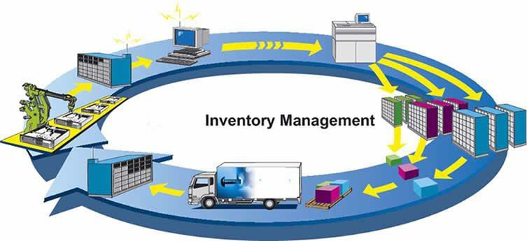
What is RL?
decisions (actions)
Actions: muscle contractions Observations: sight, smell Rewards: food
Actions: motor current or torque Observations: camera images Rewards: task success measure (e.g., running speed)
consequences observations rewards
(states)
Actions: what to purchase Observations: inventory levels Rewards: profit
Notes:
This is application of RL, why does it matter?
Mathematical formalism for learning-based decision making
Approach for learning decision making and control from experience
The main idea is quite simple: there is this agent (an algorithm) interacting with an environment through actions. These actions make the environment respond with a new state and a signal, the reward, that the agent will use as a feedback. The learning happens through trial and error. If the signal is negative the agent learns it shouldn’t be doing that. If the signal is positive, then it learns that it might be a good idea to actually do that next time. This reward is key for the agent to learn which sequence of decisions are the best.

Slide 4
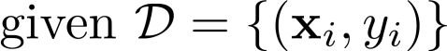
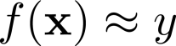
What is RL?
Standard (supervised) machine learning:
Reinforcement learning:
Data is not i.i.d.: previous outputs influence future inputs!
Ground truth answer is not known, only know
if we succeeded or failed
more generally, we know the reward
Usually assumes:
i.i.d. data
known ground truth outputs in training
Notes:
This is application of RL, why does it matter?
Mathematical formalism for learning-based decision making
Approach for learning decision making and control from experience

Slide 5

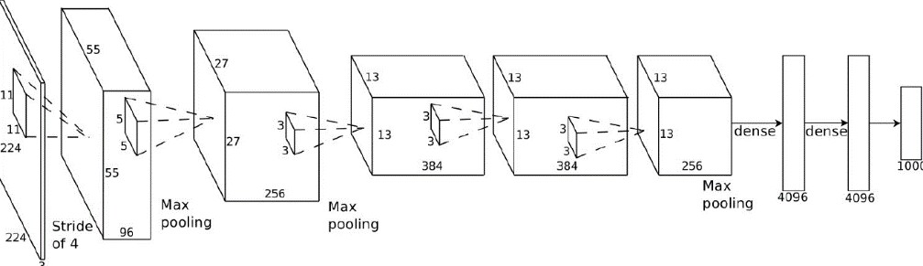
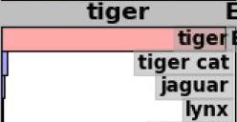
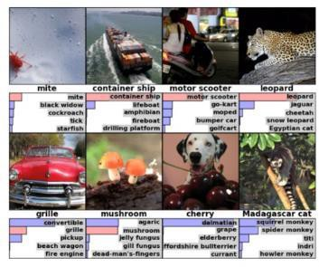
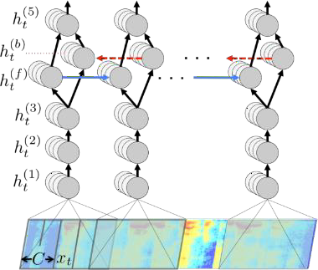

What is RL?
Deep learning helps us handle unstructured environments
Notes:
This is application of RL, why does it matter?
Mathematical formalism for learning-based decision making
Approach for learning decision making and control from experience

Slide 6
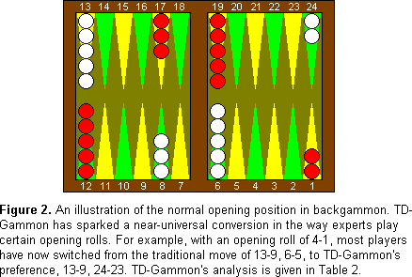



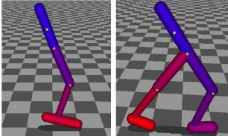
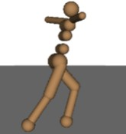
What is RL?
Reinforcement learning provides a formalism for behavior
decisions (actions)
consequences observations rewards
Schulman et al. ’14 & ‘15
Mnih et al. ‘13
Notes:
This is application of RL, why does it matter?
Mathematical formalism for learning-based decision making
Approach for learning decision making and control from experience

Slide 7
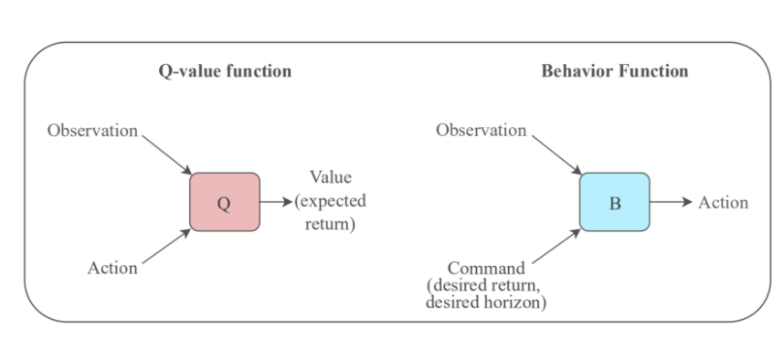
UPRL Approach
Reinforcement Learning Upside Down: Don’t Predict Rewards — Just Map Them to Actions
Training Agents using Upside-Down Reinforcement Learning
Notes:
On December 5th, famous AI researcher Jürgen Schmidhuber and his team, came up with what I consider a revolutionary idea to solve Reinforcement Learning problems: Upside-Down Reinforcement Learning. They published two papers about this idea:
Traditional RL either predict rewards with value functions (e.g. Q-Learning) or maximize them using policy search (e.g. Policy Gradient methods). Schmidhuber and his team propose something quite unique and unexpected: instead of predicting the reward, use it as an input along with the state to map to actions, literally turning RL learning upside-down.
In ⅂ꓤ (short for Upside-Down RL) instead of having a function approximator that maps state-action pair to value (expected return), we have this Behavior function (B) that maps state-command to action. And what’s a command? you might be wondering. Here is where things get interesting. A command consists of a desired return and a desired horizon.

Slide 8
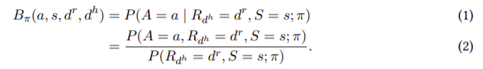
Formalization of the Behavior Function
Notes:
Formally, let the agent be given a command indicating that a return of d r is desired in the next d h steps. Let S and A be random variables denoting the environment’s state and the agent’s next action respectively. Let Rd h be the random variable denoting the return obtained by the agent during the next d h time steps. Then the behavior function Bπ produces the conditional probability that taking an action a ∈ A and thereafter acting using the policy π leads to the desired return in the desired horizon:
Assume that instead of a policy, only a dataset of trajectories T generated using an unknown policy is available, and we are interested in the behavior function BT for the dataset. With discrete states and actions, it can be estimated from the available data (following Equation 2) as
where Nκ(s, dr , dh ) is the number of trajectory segments in T that start in state s, have length d h and total reward d r , and Na κ (s, dr , dh ) is the number of such segments where the rst action was a.

Slide 9
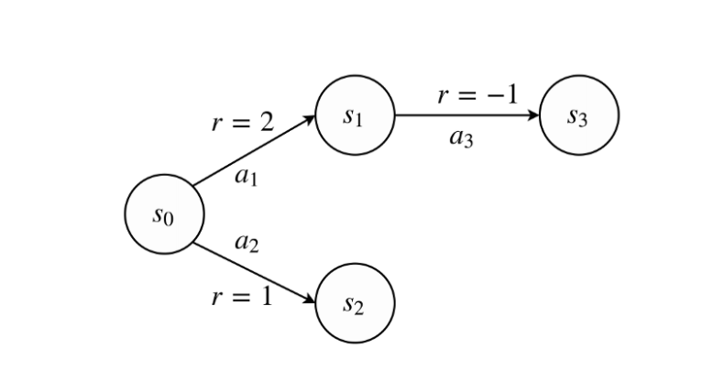
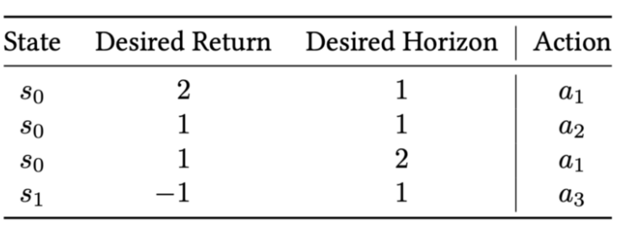
Example 1
Notes:
We have two terminal states, s2 and s3. We could be in either s0 or s1 to reach those terminal states. Now, according to this Markov Decision Process (a.k.a. MDP) if we were to explore the environment, we could end up building the table below
If we were in s0 and wanted to get a reward of 2 in 1 step, which action should the agent take?, have a look at the MDP again. It should be action a1. That one would give a 2 as a return in 1 step, landing in s1. How about getting 1 in 1 step?, remember, we’re still in state s0. Definitely not action a1, as we saw that action gives us a return of 2 in 1 step. We can take action a2, landing on state s2. Now, still on state s0, I’m gonna “command” the agent to get a reward of 1, but this time in 2 steps. Which action would get the agent there?. Let’s see, if we take a1 we get a reward of 2, landing on s1. But we’re not done yet. From there, if we take a3, we get a reward of -1 landing on s3(terminal state). Total reward 2-1=1, in 2 steps. This is exactly what I commanded my agent to do. Let’s go back then to that last command: My desired return was 1 and my desired horizon was 2 steps. This maps to that initial action the agent must take to comply with the command: a1.
Features (state, desired_return, desired_horizon) and labels (actions)… Exactly, Supervised Learning!!. We have a clear Supervised Learning problem here. And SL has proven to be quite stable and successful. ⅂ꓤ turns Reinforcement Learning into a Supervised Learning problem, training an agent on all past experiences in a supervised way.
Using SL in RL problems isn’t new at all. It’s been tried before such as in Imitation Learning, but with little success. The paper also explains in its introduction:

Slide 10
Example 1
While there is a rich history of techniques that incorporate supervised learning (SL) into reinforcement learning (RL) algorithms, it is believed that fully solving RL problems using SL is not possible, because feedback from the environment provides error signals in SL but evaluation signals in RL. Put simply, an agent gets feedback about how useful its actions are, but not about which actions are the best to take in any situation. On the possibility of turning an RL problem into an SL problem, Barto and Dietterich surmised: “In general, there is no way to do this.”
Notes:
What’s proposed in this paper bridges this gap between SL and RL, avoiding the issues arising from the combination of function approximation, bootstrapping and off-policy training.

Slide 11
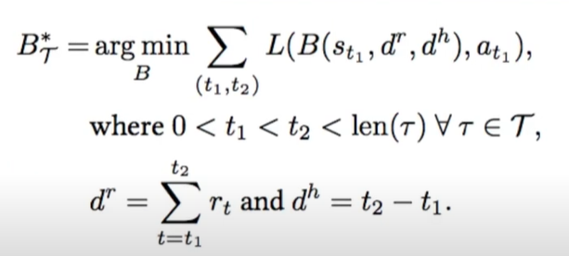
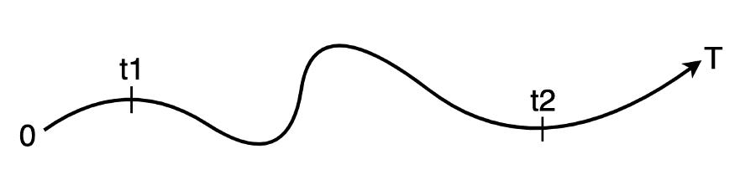
Supervised Learning Update
Notes:
Agnostic to model-free or model-based algorithms.
A trajectory is nothing more than a sequence of state, action, reward like this: [(s0,a0,r0), (s1,a1,r1), ..., (st,at,rt), ...], which we are storing in our buffer. From this trajectory we sort of cut a random section such that it follows this rule: 0≤t1<t2≤T, where t1is the initial time step, t2 is the final time step and T is the length of the episode. We have the initial state and action at step t1. Desired return is the sum of all rewards from t1 to t2, and desired horizon is t2-t1. These two form our command. With this information we have the inputs for the Behavior function: B[state,command], and we have the action, our target label, to build the loss function for the supervised learning part

Slide 12
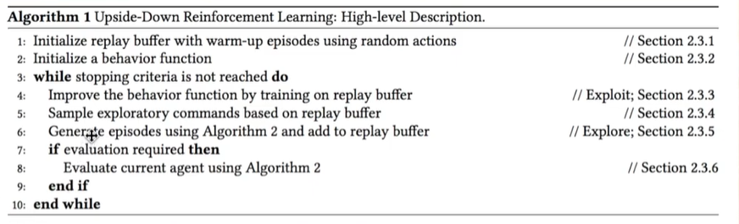
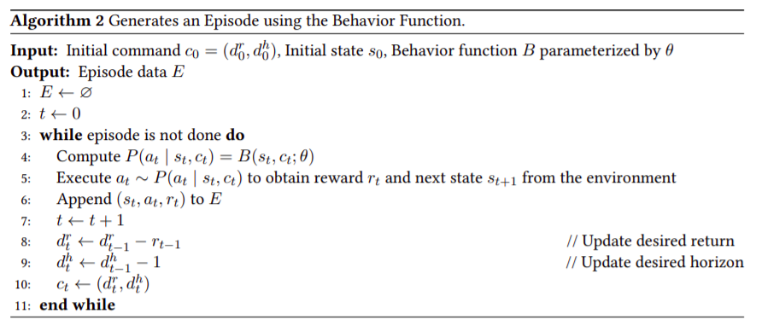
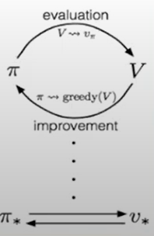
What is deep RL, and why should we care?
Notes:
Generalize policy iteration
Exploration loop
The way we sample this command is quite clever. The idea is to try to generate new, previously infeasible behaviour, potentially achieving higher returns. How can we even do that?. These are the steps:
First we select from the buffer last_few number of episodes with the highest return. Remember our buffer is sorted in ascending order by total return, so we have at the end of the buffer the highest returns.
We work out the desired horizon by calculating the mean of the lengths of those last_few episodes.
The desired return is sampled from the uniform distribution, U[M,M+S], where M is the mean and S is the standard deviation of those returns from the last_few episodes. This will try to set the desired return always higher than average, kind of pushing the agent to figure out the action that could attain such return

Slide 13
Exploration
Number of episodes from the replay buffer with the highest returns
Exploration horizon set to mean of the lengths of the episodes
Exploration returns are sampled from the uniform distribution U[M, M+S] where M is the mean and S is the standard deviation of the selected episode returns

Slide 14
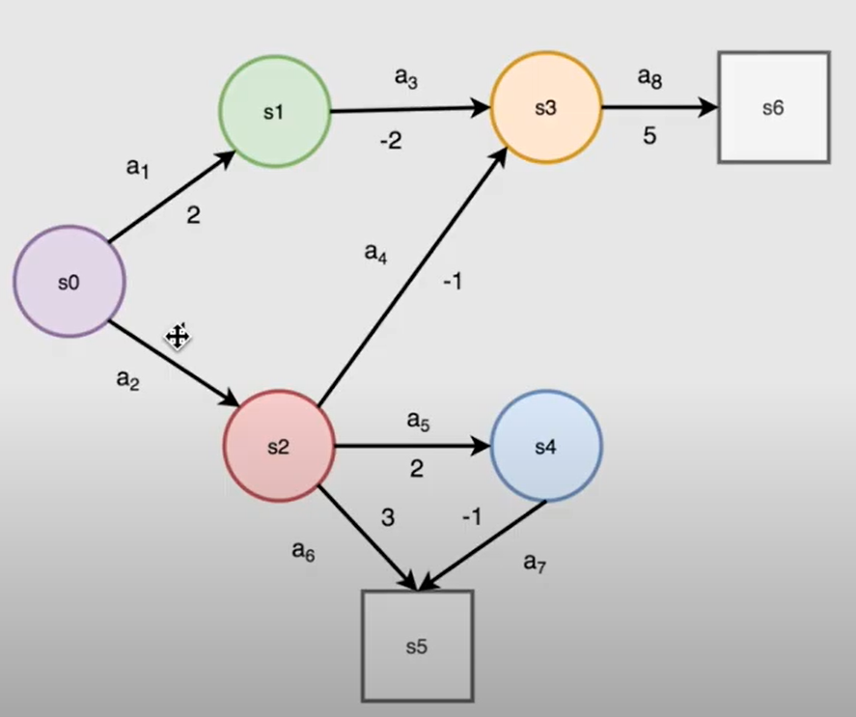
What is deep RL, and why should we care?
L(B(s0,2,3, a2)
L(B(s2,1,2), a5)
L(B(s4,-1,1), a7)
Notes:
Longer episode length for the trajectory
Different pairs in our reply buffer

Slide 15
What is deep RL, and why should we care?
L(B(s0,5,3, a2)
L(B(s2,4,2), a4)
L(B(s3,5,1), a7)
Notes:
Longer episode length for the trajectory
Different pairs in our reply buffer

Slide 16
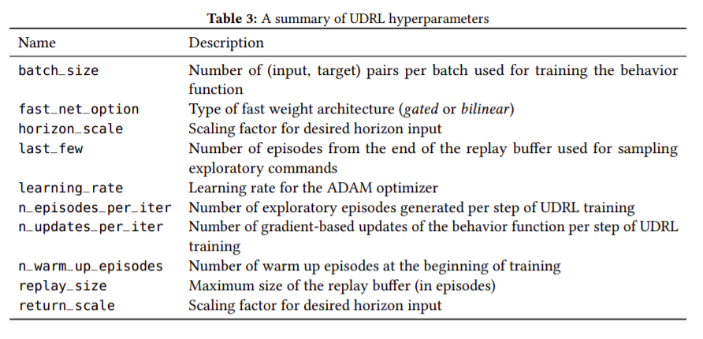
UDRL Hyperparameters

Slide 17
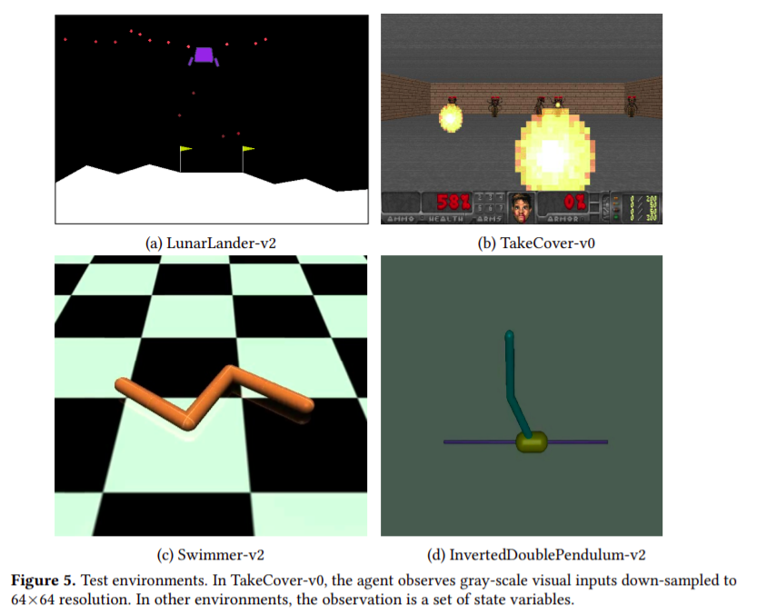
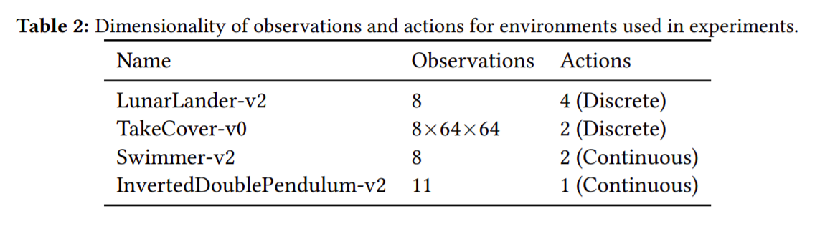
Games
Notes:
LunarLander-v2 (Figure 5a) is a simple Markovian environment available in the Gym RL library [Brockman et al., 2016] where the objective is to land a spacecraft on a landing pad by controlling its main and side engines. During the episode the agent receives negative reward at each time step that decreases in magnitude the closer it gets to the optimal landing position in terms of both location and orientation. The reward at the end of the episode is -100 for crashing and +100 for successful landing. The agent receives eight-dimensional observations and can take one out of four actions.
TakeCover-v0 (Figure 5b) environment is part of the VizDoom library for visual RL research [Kempka et al., 2016]. The agent is spawned next to the center of a wall in a rectangular room, facing the opposite wall where monsters randomly appear and shoot reballs at the agent. It must learn to avoid reballs by moving left or right to survive as long as possible. The reward is +1 for every time step that the agent survives, so for RL agents we always set the desired horizon to be the same as the desired reward, and convert any fractional values to integers. Each episode has a time limit of 2100 steps, so the maximum possible return is 2100. Due to the diculty of the environment (the number of monsters increases with time) and stochasticity, the task is considered solved if the average return over 100 episodes exceeds 750.
Swimmer-v2 and InvertedDoublePendulum-v2 are environments available in Gym based on the Mujoco engine [Todorov et al., 2012]. In Swimmer-v2, the task is to learn a controller for a three-link robot immersed in a viscous uid in order to make it swim as far as possible in a limited time budget of 1000 steps. The agent receives positive rewards for moving forward, and negative rewards proportional to the squared L2 norm of the actions. The task is considered solved at a return of 360. In InvertedDoublePendulum-v2, the task is to balance an inverted two-link pendulum by applying forces on a cart that carries it. The reward is +10 for each time step that the pendulum does not fall, with a penalty of negative rewards proportional to deviation in position and velocity from zero (see source code of Gym for more details). The time limit for each episode is 1000 steps and the return threshold for solving the task is 9100.

Slide 18
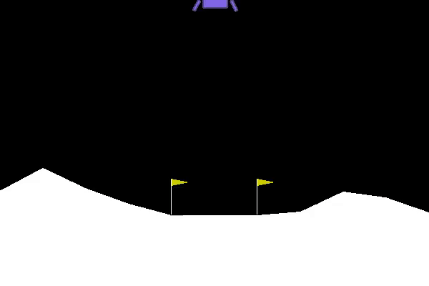

Games
Untrained Agent

Slide 19
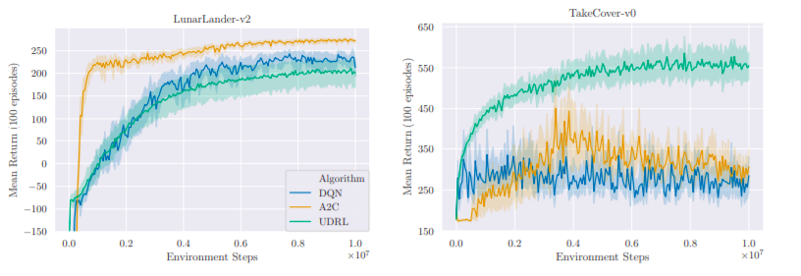
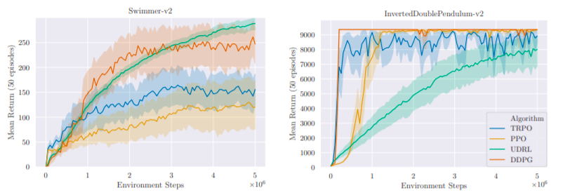
Results
Notes:
. Results on tasks with discrete-valued actions (top row) and continuous-valued actions (bottom row). Solid lines represent the mean of evaluation scores over 20 runs using tuned hyperparameters and experiment seeds 1–20. Shaded regions represent 95% condence intervals using 1000 bootstrap samples. RL is competitive with or outperforms traditional baseline algorithms on all tasks except InvertedDoublePendulum-v2.
We use environments with both low and high-dimensional (visual) observations, and both discrete and continuous-valued actions: LunarLander-v2 based on Box2D [Catto, 2014], TakeCover-v0 based on VizDoom [Kempka et al., 2016] and Swimmer-v2 & InvertedDoublePendulum-v2 based on the MuJoCo [Todorov et al., 2012] simulator, available in the Gym library [Brockman et al., 2016].
We compare to Double Deep Q-Networks (DQN Mnih et al. [2015]; Van Hasselt et al. [2016]) and Advantage Actor-Critic (A2C; synchronous version of the algorithm proposed by Mnih et al. [2016]) for environments with discrete actions and TRPO [Schulman et al., 2015], PPO [Schulman et al., 2017] and DDPG [Lillicrap et al., 2015] for environments with continuous actions.
We follow their recommendations by using separate seeds for training and evaluation and 20 independent experiment runs for all nal comparisons. We also used a hyperparameter search to tune each algorithm on each environment
All agents were implemented using fully-connected feed-forward neural networks, except for TakeCoverv0 where we used convolutional networks.
Agents were trained for 10 M environmental steps for LunarLanderv2/TakeCover-v0 and evaluated using 100 episodes at 50 K step intervals. For the less stochastic Swimmer-v2 and InvertedDoublePendulum-v2, training used 5 M steps and evaluation used 50 episodes to reduce the computational burden. Th
Simply concatenating commands with states lead to very inconsistent results, making it extremely dicult to nd good hyperparameters. We found that use of architectures with fast weights [Schmidhuber, 1992] — where outputs of some units are weights of other connections — considerably improved reliability over several runs
We included two of the simplest choices in our hyperparameter search: gating (as commonly used in LSTM [Hochreiter and Schmidhuber, 1997]) and bilinear [Jayakumar et al., 2020], using them only at the rst layer in fully-connected networks and at the last layer in convolutional ones. This design makes it dicult to ignore command inputs during training.
---
Results
. On LunarLander-v2, all algorithms successfully solved the task (reaching average returns over 200). RL performed similar to DQN but both algorithms were behind A2C in sample complexity and nal returns, which benets from its use of multi-step returns
On TakeCover-v0, RL outperformed both A2C and DQN comfortably. Inspection of the individual evaluation curves showed that both baselines had highly uctuating evaluations, sometimes reaching high scores but immediately dropping in performance at the next evaluation. This high variability led to overall lower scores when aggregated. While it may be possible to address these instabilities by incorporating additional techniques or modications to the environment, it is notable that our simple implementation of RL does not suer from them
On the Swimmer-v2 benchmark, RL outperformed TRPO and PPO, and was on par with DDPG. However, DDPG’s evaluation scores were highly erratic (indicated by large condence intervals), and it was rather sensitive to hyperparameter choices. It also stalled completely at low returns for a few random seeds, while RL showed consistent progress.
Finally, on InvertedDoublePendulum-v2, RL was much slower in reaching the maximum return on average, compared to other algorithms which typically solved the task within 1 M steps. While most runs did reach the maximum return (≈9300), some failed to solve the task within the step limit and one run stalled at the beginning of training.
Overall, the results show that while RL can currently lag behind traditional RL algorithms on some tasks, it can also outperform them on other tasks, despite its simplicity and relative immaturity

Slide 20
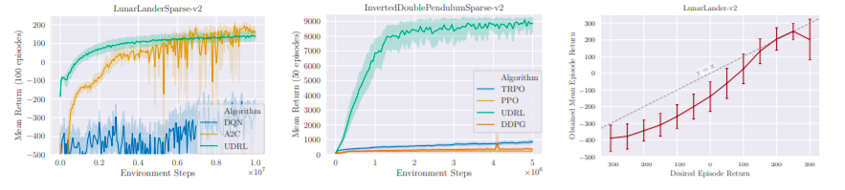
Results with Sparse Reward
Notes:
Additional experiments were conducted to examine how RL is aected as the reward function characteristics change dramatically. Since RL does not use temporal dierences for learning, it is reasonable to hypothesize that its behavior may change dierently from other algorithms that do. To test this, we converted environments to their sparse, delayed reward (and thus partially observable) versions by delaying all rewards until the last step of each episode. The reward at all other time steps was zero. A new hyperparameter search was performed for each algorithm on LunarLanderSparse-v2; for other environments we reused the best hyperparameters from the dense setting. Results for the nal 20 runs are plotted in
The baseline algorithms become unstable, very slow or fail completely as expected. Simple xes did not work; we failed to train an LSTM DQN on LunarLanderSparse-v2 (while it performed similar to A2C on LunarLander-v2), and A2C with 50 or 100-step returns. The best performing baseline on this task (A2C with 20-step returns shown in plot) was very sensitive to hyperparameters; very few settings from the search space succeeded in solving the task. RL did not exhibit such sensitivity and its behavior across hyperparameter settings was comparable to the behavior for dense rewards. It may certainly be possible to solve these tasks by switching to other techniques of standard RL.
Our aim is simply to highlight that RL retained much of its performance in this challenging setting without modication because by design, it directly assigns credit across long time horizons. On Inverted Double Pendulum, its performance improved, even approaching the performance of PPO with dense rewards.
The RL objective simply trains an agent to follow commands compatible with all of its experience, but the learning algorithm in our experiments adds a couple of techniques to focus on higher returns during training in order to make it somewhat comparable to algorithms that focus only on maximizing returns. This raises the question: do the agents really pay attention to the desired return, or do they simply learn a single policy corresponding to the highest known return? To answer this, we evaluated agents at the end of training by setting various values of d r 0 and plotting the obtained mean episode return over 100 episodes. Figure 4 (right) shows the result of this experiment on a LunarLander-v2 agent. It shows a strong correlation (R ≈ 0.98) between obtained and desired returns, even though most of the later stages of training used episodes with returns close to the maximum. This shows that the agent ‘remembered’ how to act to achieve lower desired returns from earlier training phases. We note that occasionally this behavior was aected by stochasticity in training, and some agents did not produce very low returns when commanded to do so.

Slide 21
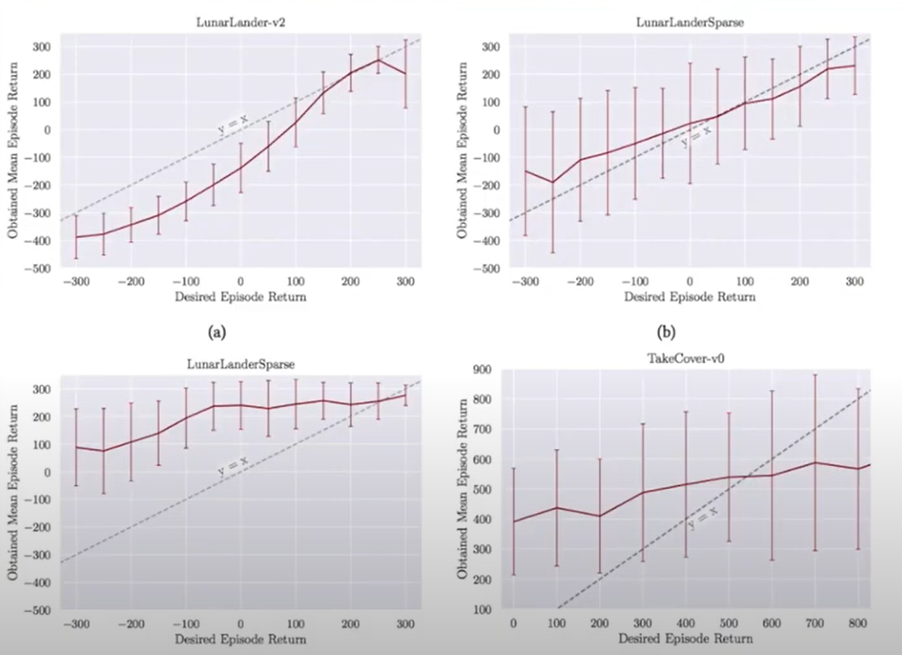
Results with Sparse Reward
Notes:
Mapping the desired

Slide 22
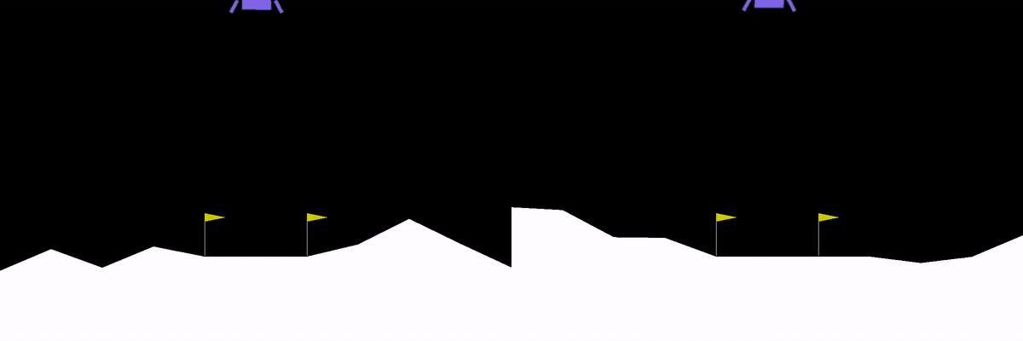
Results Demonstration
Notes:
These two gifs show a trained agent who’s given two commands with the same desired horizon of 230 steps. The synchronization is excellent:

Slide 23
Related Work
Alternate perspective on learning to act by directly associating good actions to high returns
[Lengyel and Dayan, 2008; Blundell et al., 2016]
Episodic Control
[Pritzel et al., 2017]
Model-free algorithms that learn value functions with experience replay and/or incorporate SL subroutines in many ways
[Mnih et al., 2015; Lillicrap et al., 2015; Mnih et al., 2016; Schulman et al., 2017; Oh et al., 2018]
Value functions and policies can be goal-conditional and learned by relabeling experiences in hindsight
[Schmidhuber and Huber, 1991; Kaelbling, 1993; Da Silva et al., 2012; Kupcsik et al., 2013; Deisenroth et al., 2014; Schaul et al., 2015; Pong et al., 2018; Kaelbling, 1993; Andrychowicz et al., 2017; Rauber et al., 2017]
Monte Carlo-style future prediction (i.e. without bootstrapping) can be very eective in some high-dimensional environments
[Dosovitskiy and Koltun 2016]
Gradient-based SL in recurrent networks to perform contribution analysis in order to map rewards to state-action pairs
RUDDER [Arjona-Medina et al., 2019]
Uses “task inputs” to directly produce actions, uses SL on past trajectories to remember previous skills, and does not use value functions. However, its task inputs are not constructed systematically based on previous behaviors as we do here
PowerPlay [Schmidhuber, 2013; Srivastava et al., 2013]
“RL as inference”
[Attias, 2003; Toussaint and Storkey, 2006]
Notes:
RL is conceptually more general, since it attempts to fully model potential relationships between commands and actions, and doesn’t target high returns only.
Ideas from Episodic Control were later combined with traditional value-based RL [Pritzel et al., 2017], which is also a promising future direction for RL
, but can not take full advantage of SL because they rely on bootstrapping which leads to changing targets for the same inputs.
However, what makes it dierent is that unlike goal-conditioned policies, a behavior function: (a) can take time-varying desired returns and time horizons as inputs (Algorithm 2) as opposed to xed goals, and (b) does not use value functions or policy gradients [Williams, 1992] for training, signicantly simplifying the setup for potentially utilizing a variety of SL techniques.

Slide 24
Similar Work
Recommends further analysis and deeper exaimination by readers
Defined an object very similar to our behavior function where the algorithm always retrained on data from the current policy and used to improve policy gradient estimation
[Harutyunyan et al. 2019]
Utilized pure SL to learn a policy conditioned on goals using data generated by a human operator in “play” mode
[Lynch et al. 2020]
Using pure SL and conditioning actions on fixed goal states, and similar to ours in that all data for learning is generated by the agent itself (similar to [Lynch et al. 2020])
[Ghosh et al. 2019]
Similar to UDRL though there are some differences such as use of discount factors instead of explicit horizon conditioning (proposed soon after UDRL and developed with different motivation extending recent work on Advantage-Weighted Regression [Peng et al. 2019])
RCP-R [Kumar et al., 2019]
Notes:
2. UDRL is more general in that it uses time-varying desires and horizons as inputs instead of xed goal states, and also uses the same learned behavior function for exploration instead of relying on pre-generated data
4. Since small implementation details can make a large dierence in numerical results on benchmarks, it is dicult to compare results across studies that use dierent code and evaluation protocols. Nevertheless, it is notable that Kumar et al. [2019] motivated their algorithm from the perspective of locally constrained policy improvement and further showed how advantage estimation from traditional RL may be used to improve RCP-R, albeit at the expense of additional complexity. We discuss a potential inconsistency between training and evaluation in RCP-R

Slide 25
Future Directions and Open Questions
UDRL does not have similar useful theoretical properties yet.
Many real-world problem settings, while not deterministic, are not arbitrarily stochastic either, and learning agents should (and likely do) exploit this.
Episodic Control
[Lengyel and Dayan, 2008; Blundell et al., 2016]
Avoid problems faced by traditional RL (e.g., the deadly triad)
Importance of Agent Architectures
Avoiding Temporal Distortions
Limitations in Stochastic Environments
Using recurrent instead of feedforward neural networks in order to use past observations for selecting actions
New work should utilize new semantics for command inputs such as “reach a given goal state in at most T time steps”
Exploring more complex environments
Vast open space of possible combinations of RL and algorithms based on environmental models, temporal-difference learning, optimal control and policy search
Potential applications of such algorithms include: industrial process control, robotics and recommendation systems.
Notes:
Traditional RL enjoys the benets of decades of development leading to various algorithms that can, under certain conditions, provably maximize expected returns in arbitrary stochastic environments.
why study a new type of learning for command-following agents that does not build upon well-established principles of stochastic optimal control?
A broader motivation is that in order to eectively solve the full spectrum of practical problems, as well as to fully understand the behavior of biological learning agents, it is necessary to understand the dierent ways that agents can encode knowledge and use it to act.
Consider Episodic Control [Lengyel and Dayan, 2008; Blundell et al., 2016] that, like RL, does not produce optimal expected returns in stochastic environments by itself. Instead, it models how the hippocampus may support rapid learning in vertebrates by memorizing actions that lead to high returns
may specialize in specic categories of tasks, and eventually work in concert with other techniques to yield agents with new capabilities
Avoiding the deadly triad Well-known issues arise when o-policy bootstrapping is combined with high-dimensional function approximation. This combination of techniques — referred to by Sutton and Barto [2018] as the deadly triad — can lead to instabilities which are usually addressed by adding a variety of ingredients, though complete remedies remain elusive [van Hasselt et al., 2018]. RL’s central feature is the behavior function, a method to compactly encode knowledge about any set of past behaviors in a new way. It works fundamentally in concert with high-capacity function approximation to exploit regularities in the environment. Instead of making predictions about long-term horizons conditioned on a policy (as value functions do), it learns to produce immediate actions conditioned on desired future outcomes. It opens up the exciting possibility of easily importing a large variety of techniques developed for supervised learning from highly complex data into RL.
Importance of agent architectures Our goal throughout this study was to understand the practical viability of the basic principles of RL while keeping the experimental setup as simple as possible, particularly in terms of the agent architecture and training strategies such as additional objectives or regularization. However, after the rst phase of experiments, it became clear that it is extremely dicult to reliably train plain neural networks (whose inputs are a concatenation of observations and commands) as useful behavior functions. An important takeaway from our attempts is that the RL objective alone isn’t sucient — in practice it is crucial that the model class for the behavior function is chosen such that in any state, the appropriate action to take depends strongly on the command input.
Avoiding Temporal Distortions Many RL algorithms use discount factors that distort true returns. They are also very sensitive to the frequency of taking actions, limiting their applicability to robot control [Plappert et al., 2018]. RL explicitly takes into account observed rewards and time horizons in a precise and natural way, does not assume innite horizons, and does not suer from distortions of the RL problem. In systems that require high-frequency control, even small real-time intervals lead to extremely long horizons, but this is not a conceptual hurdle in RL since real-time horizons can directly be used as part of the command inputs. Our experiments that use step-time horizons as part of commands serve as a successful rst step towards such applications. Note that other algorithms such as evolutionary RL [Moriarty et al., 1999] can also avoid these issues in other ways.
Limitations in Stochastic Environments RL relies on retrospectively generating training data based on achieved commands (instead of what was desired), but it is important to remember this scheme does not yield optimal trajectories for the fullled commands in stochastic environments. It only provides example trajectories that can fulll certain commands. Theoretically analyzing its performance in general stochastic settings, especially when taking generalization of the behavior function into account, is an open problem. Note that techniques closer to traditional RL also face theoretical issues when goals are generated in hindsight in stochastic environments (see discussion of HER by Plappert et al. [2018, Sec. 2]). Like HER, RL does not appear to be hindered by them in practice. A possible explanation is that in many environments with limited stochasticity, the agent can recover from “unexpected" stochastic transitions by reacting to the actual resulting state and reward observed.
necessary for partially observable settings, and likely useful even in fully observable settings. . In general, a wide variety of well-known SL techniques for model design, regularization and training can be employed to improve RL’s learning stability and eciency
Similarly, using a constant number of exploratory episodes per iteration decreases sample eciency and is likely unnecessary. We also expect that hyperparameters such as the number of optimization updates per iteration can be automatically adjusted during training
xperiments in this paper used a very simple form of exploration enabled by the behavior function: simply attempt to achieve high returns by generalizing from known states and returns. This was sucient to drive learning in the tested environments with a small number of action dimensions and enough stochasticity to help discover new behaviors to learn from. In other environments, additional forms of undirected (random) and directed exploration should accelerate training and may be necessary
In traditional RL, a successful agent is one that obtains optimal expected returns in stochastic environments. However, from the RL perspective, a successful agent is one that can correctly follow a large variety of commands. This paper leaves open the question of bridging these two perspectives, but presents evidence suggesting that doing so is likely to be valuable for developing learning agents that are useful in a variety of environments.
By attempting to bridge supervised and reinforcement learning, its goal is to make solving RL problems easier and more scalable. As such, it has the potential to increase both positive and negative impacts of RL research. An example of potential positive impact is industrial process control to reduce waste and/or energy usage — industrial combustion is a larger contributor to global greenhouse gas emissions than cars [Friedmann et al., 2019]. Examples of negative impact include unexpected job losses that can have long-term impact on many sections of the society, and feedback loops in online recommendation systems that can maximize engagement with misleading or harmful content.
Our algorithm relies on powerful non-linear function approximators like neural networks in a more direct way than traditional RL algorithms. Such functions are relatively poorly understood theoretically even in the supervised setting. RL agents that use them can behave in unexpected ways, and care must be taken to rigorously test them in safe environments and implement safeguards for preventing and controlling unintended behavior.

Slide 26
Questions?

